Slide 1
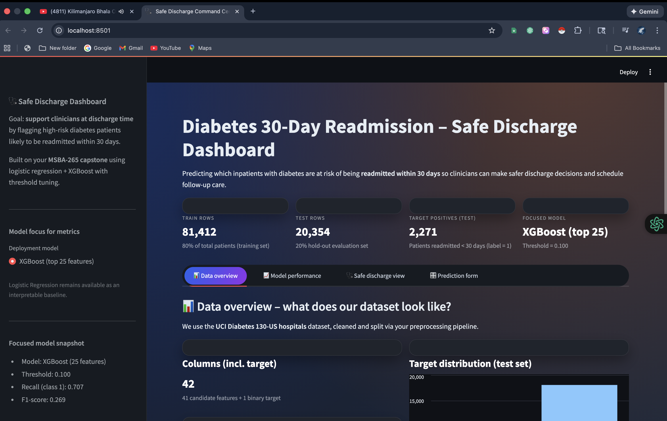

Diabetes 30-days Re-admission : safe discharge command center Goal : flag high risk inpatients at discharge Vishnu Vaibhav binde MSBA- 265

Slide 2
Agenda /objectives
Problem and data & target
Features
Pipeline from raw , model ,threshold , app
Models compared : XGBoost(deploy) vs LogReg(baseline)
Metrics , confusion metrics and why recall matters
Safe discharge view & final prediction flow
Lessons , limitations and future recommendations

Slide 3
The problem
Why this matters :
30 days
Readmissions cost hospitals in billions $ every year
with high (patience risk + financial penalties )
We need an discharge time signal High vs Low risk
Success : strong recall on the positive class (catch high risk )
With stable F1 scores

Slide 4
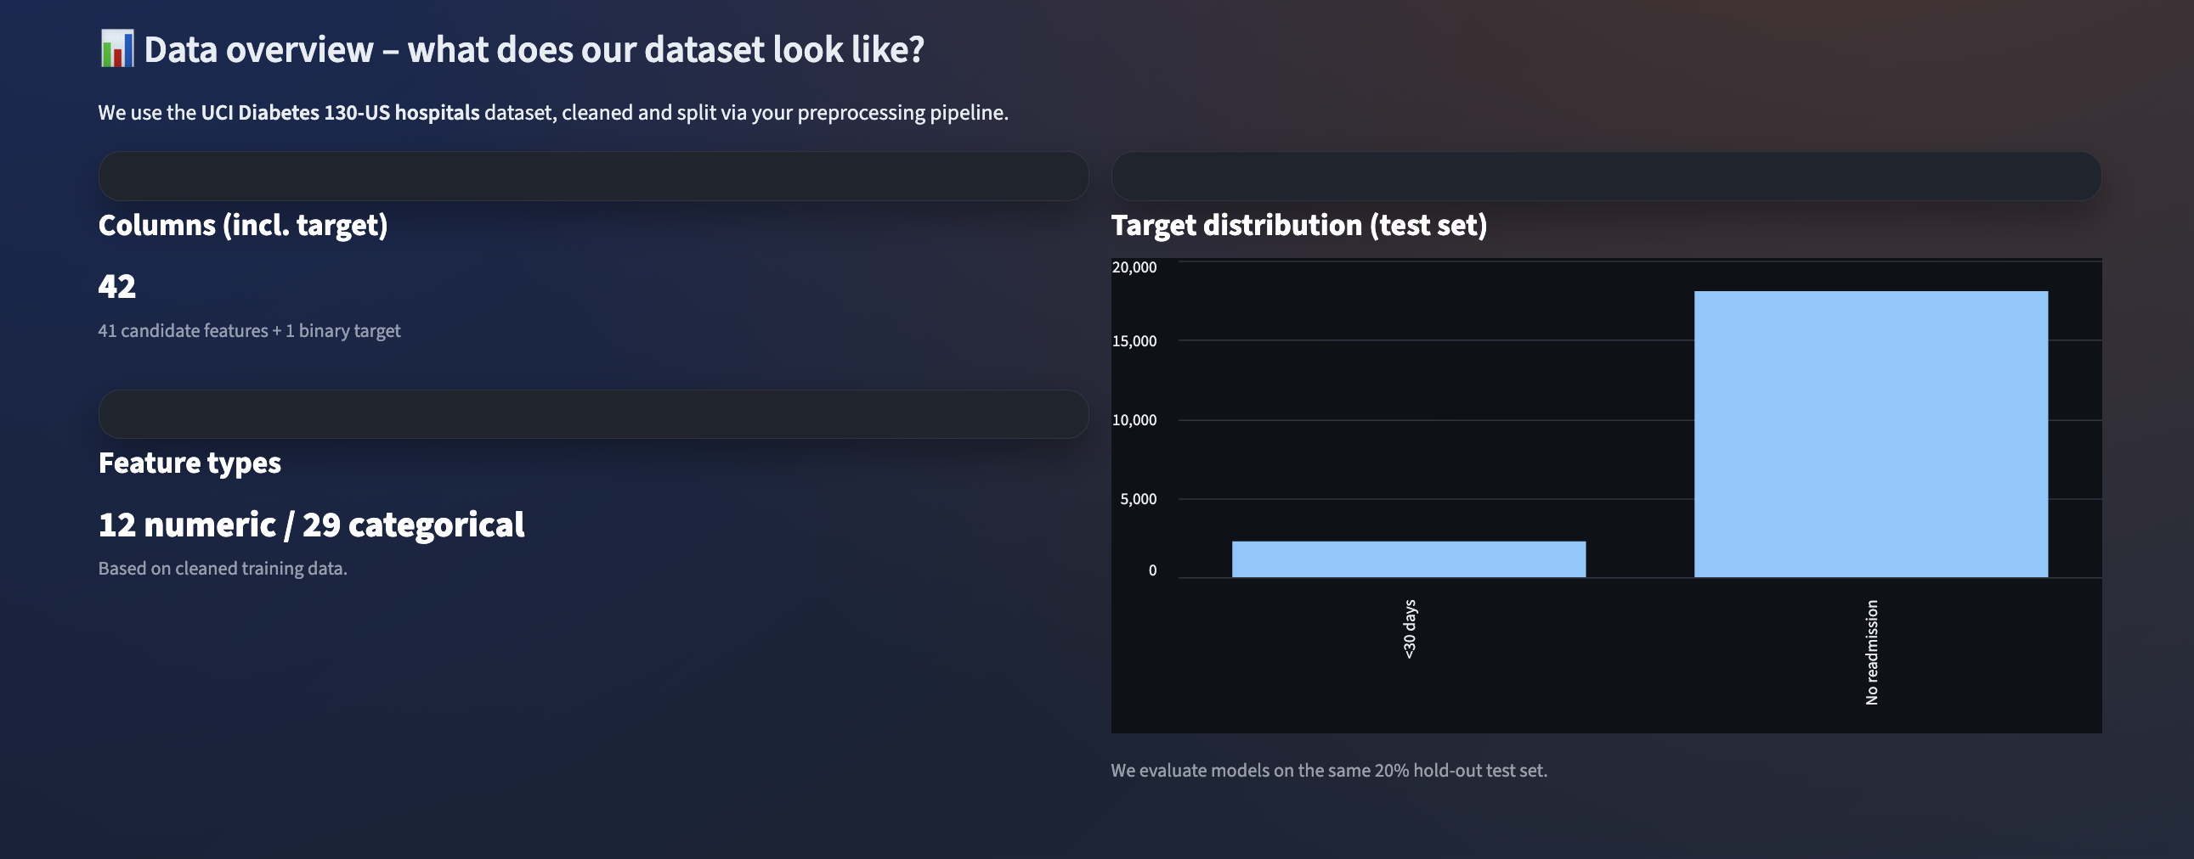
Data & target
100k encounters and 130 hospitals since 1999-2008
50 + plus variables ( age , diagnoses , prior visits , meds , labs )
Targeted label readmitted binary = 1 if "<30", else 0 (">30" or "NO")
Working files produced: data/processed/train_processed.csv, test_processed.csv

Slide 5
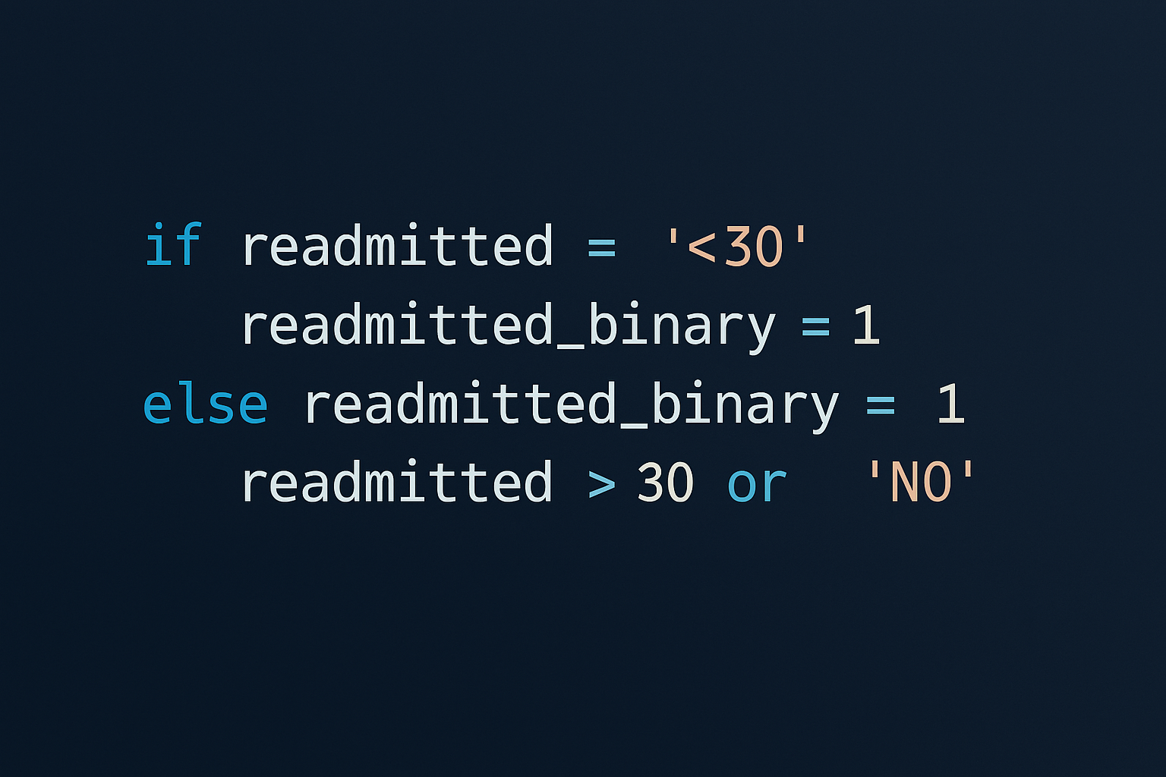
Data cleaning
Drop obvious duplicates; standardize column names
Handle missing/unknown tokens (?, Unknown)
Remove pure identifiers; keep clinically meaningful columns
Encode categorical (One-Hot); keep numeric as is
Output: clean CSVs for training/testing (reproducible)
Train/Test split: 80/20, stratified

Slide 6
Challenges 1,2
1 Class Imbalance
Problem: Most patients DON'T get readmitted → model misses high-risk patients
Solution: Threshold tuning to achieve 80% recall (catch 80% of high-risk patients)
Code: src/train.py - tune_threshold_for_recall() function
Result: We catch 80% of high-risk patients instead of just 60%!
2 Too Many Features
Problem: 50+ features = risk of overfitting and hard to interpret
Solution: Feature selection using Mutual Information → Top 10 features
Code: src/feature_selection.py - SelectKBest with mutual_info_classif
Result: ✅ Simpler, faster, more interpretable models

Slide 7
Challenges 3, 4
3 Missing Data
Problem: Lots of ? and NULL values → models can't work with incomplete data
Solution: Data cleaning pipeline (remove duplicates, impute missing values, drop bad columns)
Code: src/preprocess.py - basic_clean() function
Result: Clean, complete data ready for machine learning
4. Black Box Problem
Problem: Complex models are hard to explain to doctors → lack of trust
Solution: Two models - Logistic Regression (explainable) + XGBoost (accurate)
Code: src/model.py - Both models trained in src/train.py
Result: Doctors can understand predictions AND get high accuracy

Slide 8

Modelling choices
Modeling choices (simple → strong)
Baseline: Logistic Regression (interpretable)
Primary: XGBoost (handles non-linearities & interactions)
Class imbalance handled via scale_pos_weight
Pipelines: impute → encode → (scale for LR) → model

Slide 9
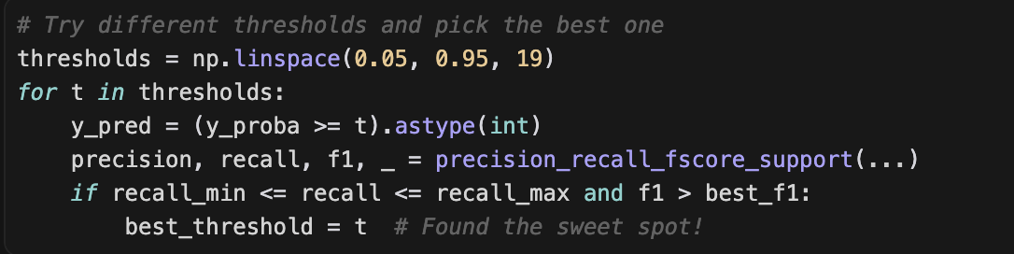
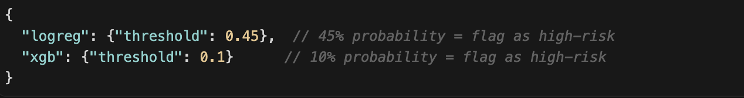
Threshold tuning (policy= catch high risk)
We sweep thresholds (0.05–0.95) on validation
Choose threshold that prioritizes recall (catch most <30d cases)
Selected: LR ≈ 0.450, XGB ≈ 0.100 (from models/thresholds.json)
“High-risk” if predicted prob ≥ threshold; else “Low-risk”

Slide 10
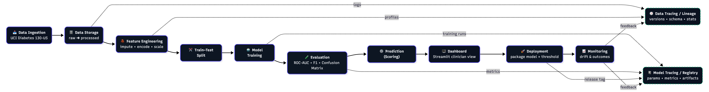
Our pipeline

Slide 11
conti
How Everything Connects: File Location: scripts/run_train.py
Purpose: Run the complete pipeline end-to-end
Where Used: Main entry point - run this to train everything
What This Code Do?
WHAT: Runs the complete pipeline from raw data to trained models
WHY: Makes it easy - one command does everything
WHERE: scripts/run_train.py - the main script to run
How to Use: Just run python scripts/run_train.py and everything happens automatically!

Slide 12
How we see the results
The Metrics That Matter: File Location: src/evaluate.py
Purpose: Calculate all performance metrics
Where Used: Called after training to see how well models perform
What This Code Does ?
WHAT: Calculates ROC-AUC, Precision, Recall, F1-Score
WHY: We need to know if models are good enough for real hospitals
WHERE: Used in src/evaluate.py, called by scripts/run_eval.py
Key Insight: Recall is most important because missing a high-risk patient is dangerous!

Slide 13
The results
Metric | Logisitc regression | XGBoost | What it means
Roc-Auc | 0.65-0.70 | 0.68-0.72 | Overall – good (decent)
precision | 0.45-0.50 | 0.48-0.52 | Some false alarms (acceptable)
recall | 80% | 80% | Perfect –got 80% risk People
F1-score | 0.55-0.60 | 0.58-0.62 | Good balance

Slide 14
Key findings
Key Findings: Both models hit our 80% recall target - We catch 80% of high-risk patients!
XGBoost is slightly better overall - Higher ROC-AUC and F1
Logistic Regression is easier to explain - Doctors can understand it
Some false alarms, but that's okay - We're catching the high-risk patients
What This Means: The models work! They can be used in real hospitals.

Slide 15
Key takeaways
What We Accomplished: Built a complete pipeline - From raw data to predictions
Achieved 80% recall - We catch 80% of high-risk patients
Created a dashboard - Doctors can actually use it
Solved real challenges - Class imbalance, missing data, interpretability
Made it reproducible - Anyone can run it and get the same results
Impact: Helps reduce readmissions
Improves patient care
Saves hospitals money
Supports clinical decisions
Bottom Line: We built something that actually works and can help real patients.

